Slide 1
DEPARTMENT OF ELECTRONICS AND COMMUNICATION ENGINEERING
FINAL REVIEW
AN EFFICIENT VLSI DESIGN OF HIGH-SPEED COUNTER WITH STATE EXTENSION LFSR
BATCH NUMBER :
BATCH MEMBERS:
PROJECT SUPERVISOR:

Slide 2
ABSTRACT
This paper presents a groundbreaking Hybrid Linear Feedback Shift Register (LFSR) design for high-speed counters, integrating traditional LFSR architecture with XOR logic to enhance efficiency and performance.
By incorporating a state extension mechanism, the proposed architecture extends the counter's capacity to handle larger counting ranges while maintaining high throughput.
Leveraging Verilog HDL for design and implementation ensures compatibility for hardware description and synthesis, with validation conducted through simulation using Model Sim and synthesis using Xilinx tools.
This innovative approach offers a promising solution for high-speed counting applications with extended range requirements, representing a significant advancement in VLSI design and digital integration methodologies.
The innovative fusion of LFSR and XOR logic in our Hybrid LFSR design offers a promising solution for high-speed counting applications with extended range requirements.
By harnessing the combined strengths of these two elements, we achieve unprecedented levels of efficiency and versatility, paving the way for enhanced performance in diverse real-world applications.

Slide 3
OBJECTIVE
Develop a high-speed counter architecture capable of efficiently handling large counting ranges.
Utilize a Linear Feedback Shift Register (LFSR) as the core component for fast and scalable counting operations.
Integrate a novel state extension mechanism within the LFSR to extend the counter's capacity without sacrificing speed.
Optimize resource utilization to achieve a balance between performance and hardware complexity.
Implement the counter design using Verilog HDL for hardware description and synthesis compatibility.
Verify the functionality and performance of the counter through simulation using ModelSim.
Perform synthesis using Xilinx tools to generate the hardware configuration for FPGA implementation.
Evaluate the effectiveness of the proposed counter architecture in meeting high-speed counting requirements with extended range capabilities.

Slide 4
INTRODUCTION
Counters are fundamental components in digital systems, serving a myriad of purposes ranging from basic timekeeping to complex data processing.
Their functionality extends across various domains, including telecommunications, computing, and instrumentation.
Traditional counter designs often face inherent limitations, particularly in balancing speed and counting range. Linear Feedback Shift Registers (LFSRs) have emerged as a compelling solution due to their simplicity, speed, and versatility.
LFSRs, initially devised for generating pseudo-random sequences, offer inherent parallelism and high clock frequencies, making them well-suited for high-speed counting applications.
By introducing this novel high-speed counter with a novel LFSR state extension mechanism, we endeavor to push the boundaries of digital counter design, offering a solution that excels in both speed and counting range, thereby catering to the evolving needs of modern digital systems.
Our aim is to develop a high-speed counter with extended counting range capabilities through the integration of a novel LFSR state extension mechanism.
This project explores the synergy between advanced digital design techniques and the inherent properties of LFSRs to address the challenges associated with traditional counter architectures.

Slide 5
DOMAIN DESCRIPTION
Domain
VLSI Design
Part used our Project
Higher Accuracy in arithmetic Operations
Area, Delay optimization
Purpose of this Project
Improve the Area, Delay Efficiency of Linear Feedback Shift Registers

Slide 6
LITERATURE SURVEY
S no | Title | Author / year | Description
1. | New Programmable LFSR Counters with Automatic Encoding and State Extension | Martin Grymel 2024 | The picture upgrade techniques are talked about in detail. The strategies proposed in the literary works were arranged into four unique gatherings in light of the procedures. The disadvantages and focal points of the techniques are likewise clarified in detail
2. | High-Speed Counter With Novel LFSR State Extension | Hyungjoon Bae; Yujin Hyun; Suchang Kim 2022 | This paper presents a high-speed counter architecture associated with novel LFSR state extension. By employing the proposed state extension, an m -bit LFSR counter with (2m−1) states is modified to cover 2m states without degrading the counting rate.

Slide 7
LITERATURE SURVEY
S no | Title | Author / year | Description
3. | Low Power Implementation of Linear Feedback Shift Registers | Jayasanthi M, Kowsalyadevi AK 2019 | This paper describes low power design and implementation of Linear Feedback Shift Register (LFSR). The easiness in implementation and simple operation of Linear Feedback Shift Register have made it fit into a wide range of digital systems design
4. | Multistage Linear Feedback Shift Register Counters With Reduced Decoding Logic in 130-nm CMOS for Large-Scale Array Applications | Daniel Morrison; Dennis Delic; Mehmet Rasit Yuce; Jean-Michel Redouté 2018 | Linear-feedback shift register (LFSR) counters have been shown to be well suited to applications requiring large arrays of counters and can improve the area and performance compared with conventional binary counters. However, significant logic is required to decode the count order into binary, causing system-on-chip designs to be unfeasible

Slide 8
LITERATURE SURVEY
S no | Title | Author / year | Description
5. | A Hardware-Friendly Approach Towards Sparse Neural Networks Based on LFSR-Generated Pseudo-Random Sequences | Foroozan Karimzadeh; Ningyuan Cao; Brian Crafton; Justin Romberg 2020 | The increase in the number of edge devices has led to the emergence of edge computing where the computations are performed on the device. In recent years, deep neural networks (DNNs) have become the state-of-the-art method in a broad range of applications, from image recognition, to cognitive tasks to control.

Slide 9
PROBLEM STATEMENT
The problem at hand involves the inherent limitations of traditional counter designs in achieving a balance between high-speed operation and extended counting ranges.
While counters are crucial components in digital systems, existing architectures often struggle to meet the demands of contemporary applications requiring both rapid counting rates and the ability to handle large counting ranges.
Linear Feedback Shift Registers (LFSRs) offer a potential solution due to their simplicity and speed, yet their finite state sizes restrict their counting capacity.
Therefore, there is a critical need to develop a novel counter architecture that leverages LFSRs while extending their counting capability, addressing the challenges of traditional designs and meeting the evolving requirements of modern digital systems.

Slide 10
EXISTING SYSTEM
In the realm of digital electronics, traditional counter designs have long been the cornerstone of numerous applications, providing essential functionality for tasks such as frequency division, event counting, and sequence generation.
However, despite their widespread use and effectiveness, traditional counter architectures are not without their limitations. Understanding the existing system and its drawbacks is crucial for identifying opportunities for improvement and innovation.
Traditional counter architectures typically consist of a chain of flip-flops connected in a predetermined sequence, with each flip-flop triggering the next in line upon reaching a certain state. These counters come in various forms, including ripple counters, synchronous counters, and up/down counters, each tailored to specific applications and requirements.
While these designs have served as reliable workhorses in digital systems for decades, they exhibit several inherent drawbacks that can hinder their performance and scalability in certain scenarios.

Slide 11
DRAWBACKS
Complexed Area More Delay.
Complex architecture for Testing

Slide 12
EXISTING SYSTEM TECHNIQUE
High-speed counters primarily rely on synchronous counter architectures.

Slide 13
PROPOSED METHOD
In the proposed pre-scaled counter architecture, an N-bit counter that generates Q[N1:0] is composed of two sub-counters, m-bit wide CL and (N-m)-bit wide CH.
The CL sub-counter is an LFSR associated with the proposed state detection, but the CH sub-counter is realized with a conventional binary counter as it counts only once during the time that CL traverses all 2m states.
The m-bit LFSR counter CL generates m-bit states represented in Q[m1:0], and the binary counter CH provides binary states expressed in Q[N1:m].the proposed counter is compared to the conventional synchronous binary counter and the multistage LFSR counter
The performance is analyzed in terms of the maximum counting rate of single-stage block counters that range from 3 bits to 10 bits, and the maximum counting rate and the hardware complexity of practically sized counters that range from 16 bits to 64 bits.

Slide 14
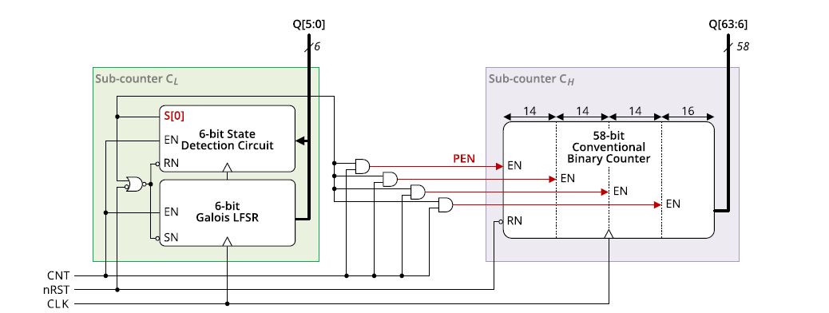
BLOCK DIAGRAM

Slide 15
PROPOSED ALGORITHM
we present a high-speed counter associated with a novel state extension.
The proposed counter consists of an LFSR sub-counter and a binary sub-counter, and its delay is almost constant regardless of the counter size.
The proposed LFSR counter has a state detection circuit to extend the number of states from (2^{m}-1) to 2m without degrading the counting rate for an m-bit LFSR
Our proposed technique introduces a pioneering approach to high-speed counter design through the integration of a Hybrid Linear Feedback Shift Register (LFSR).

Slide 16
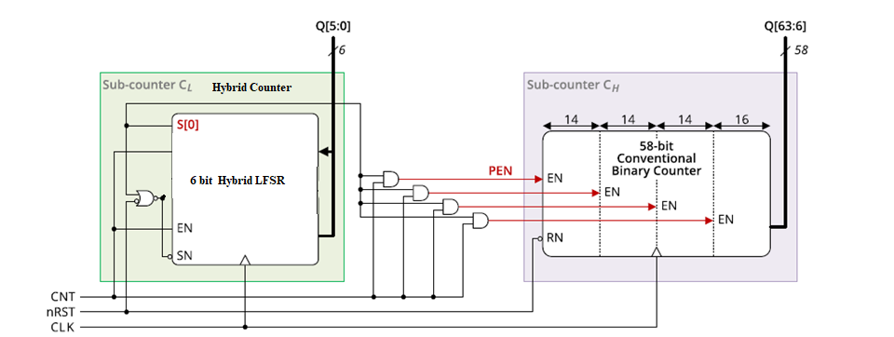
MODIFIED DIAGRAM

Slide 17
PROPOSED SYSTEM ADVANTAGES:
Better performance in Delay
Low-energy high-throughput

Slide 18
SOFTWARE REQUIREMENT
Simulation Tool: Modelsim 6.4c
Language: Verilog HDL
Synthesis Software: Xilinx 13.2
Hardware: Spartan 3

Slide 19
REAL TIME APLLICATIONS
Telecommunications
Signal Processing
Instrumentation and Measurement
Embedded Systems
Digital Control Systems

Slide 20
PROPOSED SYSTEM ADVANTAGES
Low-power Design
Low-energy high-throughput

Slide 21
SOFTWARE & HARDWARE REQUIREMENT
Simulation Tool - Modelsim 6.4c
Synthesize Tool - Xilinx tool
Hardware - FPGA Spartan 3 XC3S 200TQ-144

Slide 22
MODULES DESCRIPTION
Module 1: Parallel Counter Architecture Design
Divide the counter into parallel stages, where each stage counts a subset of bits simultaneously.
Determine the number of parallel stages based on throughput requirements and target clock frequency.
Implement each parallel stage as a separate module, with inputs and outputs for data propagation between stages.
Ensure synchronous operation of all stages to maintain consistency in counting.
Module 2: Pipeline Register Insertion
Identify critical paths in the counter architecture, i.e., paths with the longest propagation delay.
Insert pipeline registers along these critical paths to break down the computation into smaller stages.
Determine the optimal placement of pipeline registers to balance timing constraints and minimize clock cycle time.
Implement each pipeline register as a separate module, inserting them between appropriate stages of the counter architecture.

Slide 23
Module 3: Linear Feedback Shift Register (LFSR):
Design an LFSR module to generate pseudo-random sequence for state extension.
Determine the feedback polynomial based on the desired sequence length and properties.
Implement the LFSR module with shift and feedback logic to generate the sequence.
Ensure synchronization of LFSR output with the counter operation for proper state extension.
Module 4: Control Logic:
Design control logic to manage the operation of the counter, including initialization, counting, and state extension.
Implement control signals for enabling/disabling counting, resetting the counter, and controlling LFSR state extension.
Ensure proper synchronization and timing of control signals with the counter and LFSR operation
Module 5: Output Interface
Design an output interface module to capture and output the counter value.
Implement necessary logic for latching the counter value and providing it to external circuitry.
Ensure synchronization of output data with the clock signal to avoid metastability issues.

Slide 24
REAL TIME APLLICATIONS
Signal Processing: Real-time processing of signals in communication systems, where the speed and energy efficiency of the approximate parallel prefix adder can enhance tasks like filtering, modulation, and demodulation.
Image and Video Processing: Accelerating real-time image and video processing applications, such as object recognition and tracking, where the algorithm's optimized resource usage is beneficial for handling large datasets.
Embedded Systems: Integration into embedded systems for real-time applications like robotics, where the algorithm's efficiency contributes to faster decision-making and precise control.
Digital Signal Processors (DSP): Implementation in DSPs for real-time audio processing applications, taking advantage of the algorithm's ability to balance accuracy and resource efficiency in computationally intensive tasks.

Slide 25
Machine Learning Accelerators: Deployment in hardware accelerators for machine learning algorithms, leveraging the optimized architecture to enhance the speed and efficiency of approximate computations in neural networks.
Cryptographic Systems: Integration into cryptographic systems for real-time encryption and decryption, benefiting from the algorithm's capacity to handle complex arithmetic operations efficiently.

Slide 26
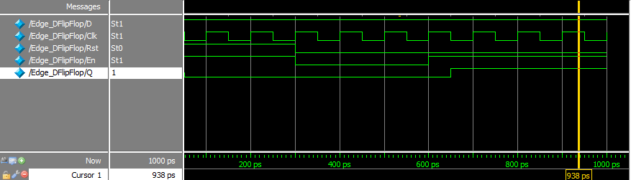
RESULT
DFF:

Slide 27
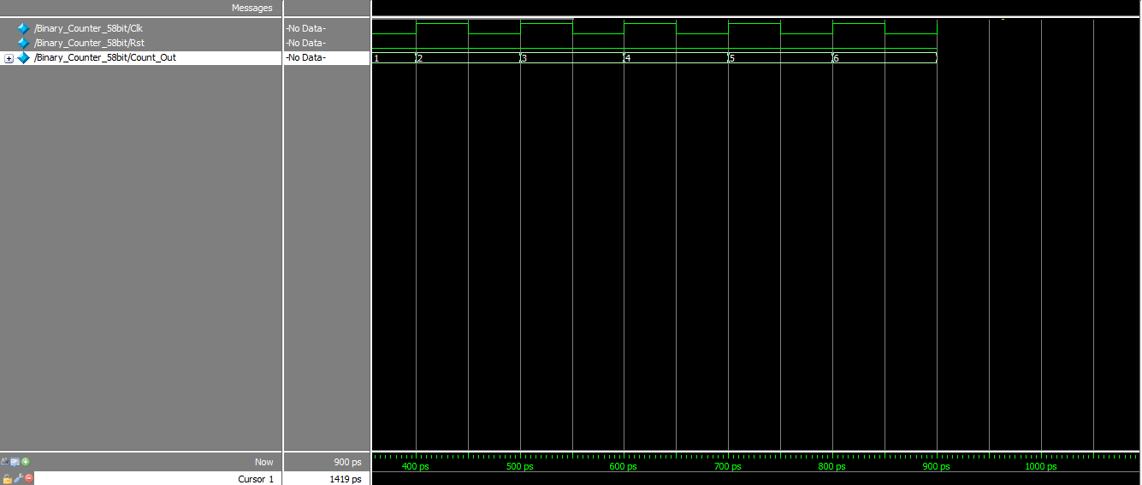
COUNTER DESIGN:

Slide 28
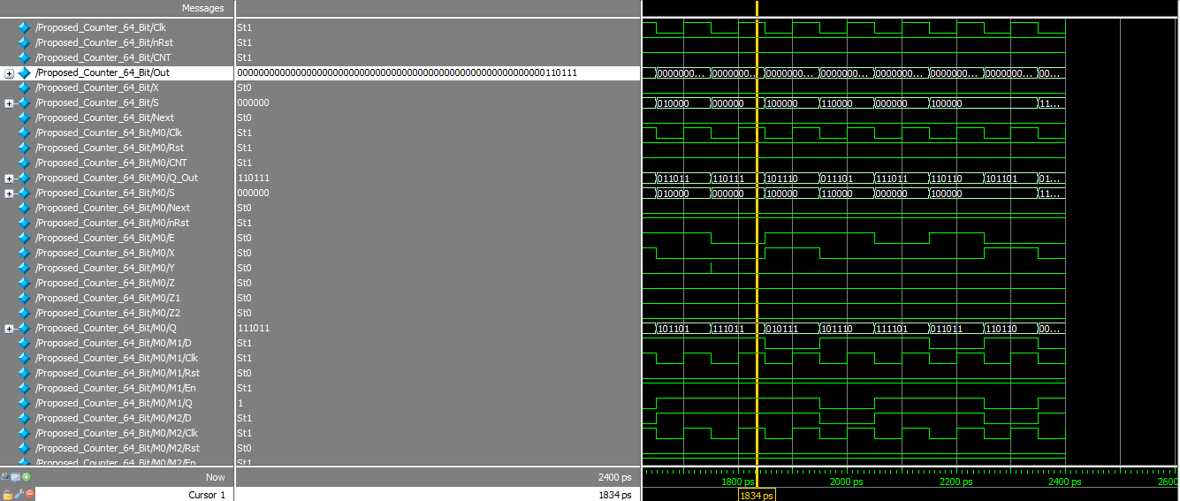
PROPOSED DESIGN

Slide 29
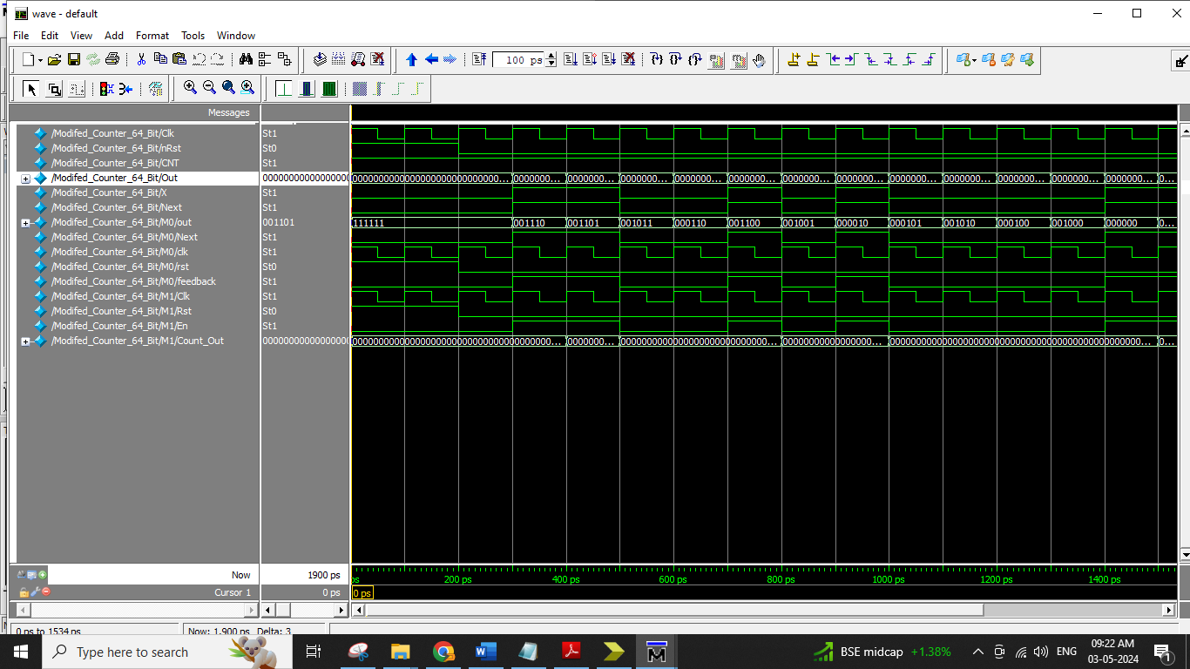
MODIFIED HYBRID DESIGN:

Slide 30


Slide 31
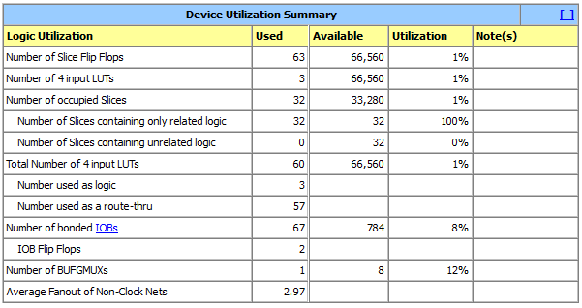
SYNTHESIS RESULTS
MODIFIED HYBRID DESIGN

Slide 32
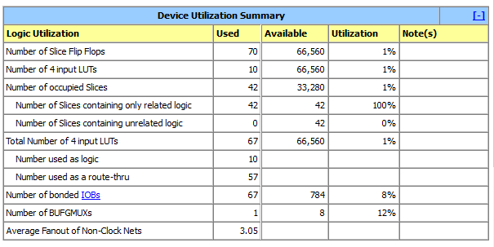
PROPOSED:

Slide 33
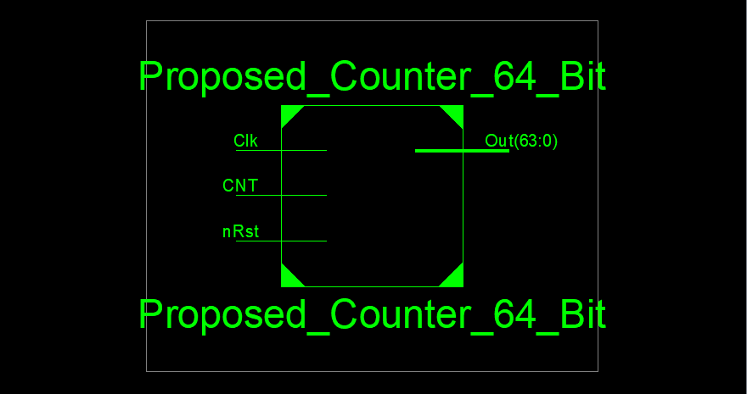
RTL SCHEMATIC

Slide 34
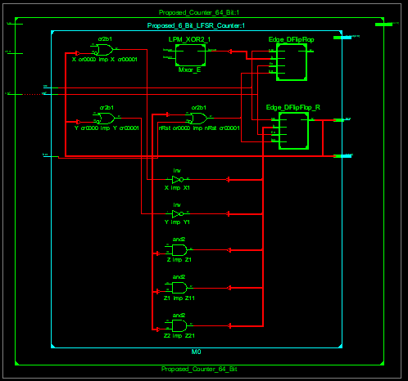

Slide 35
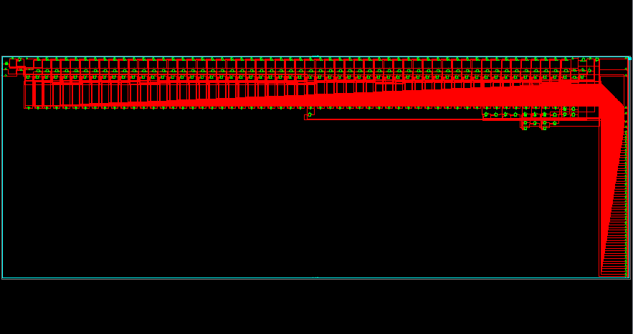
TECHNOLGY SCHEMATIC:

Slide 36
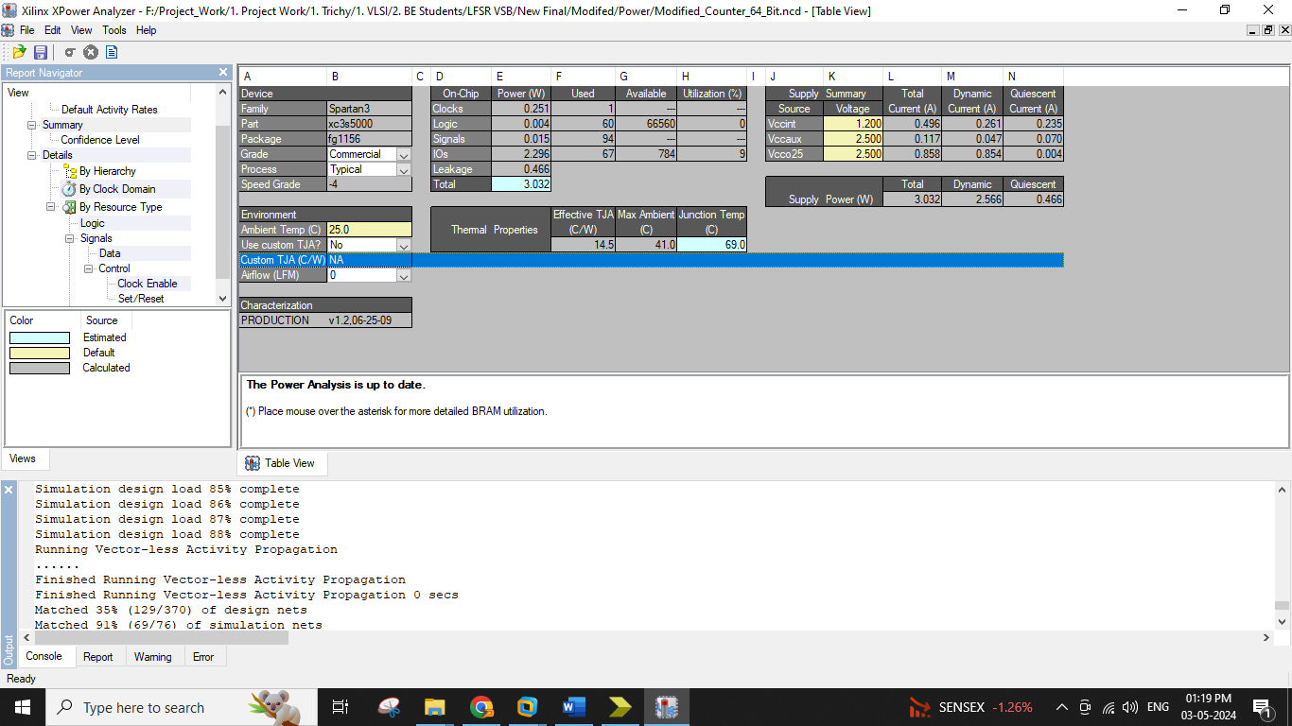
POWER
Modified:

Slide 37
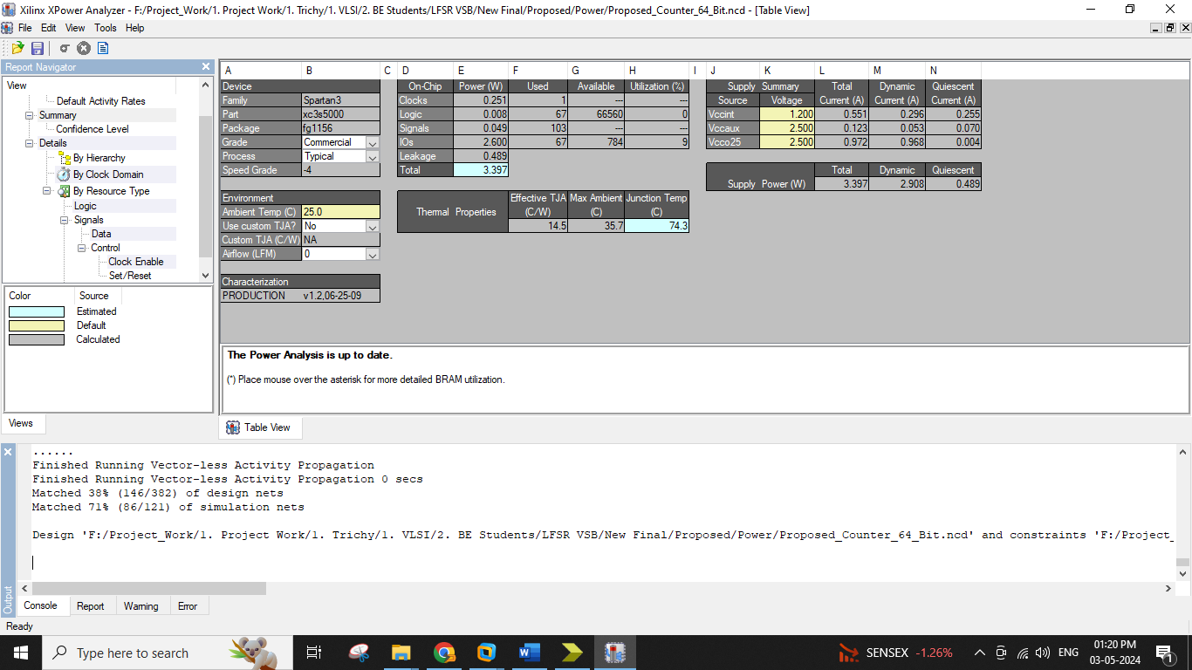
Proposed

Slide 38
AREA POWER COMPARISON:
Method Name | Area in Number of LUT |  |  | Delay |  |  | Power
Spartan 3 XC 3S 5000-4FG1156 | LUT | Slices | Flip Flop | Delay | Gate or Logic Delay | Path or Route Delay | mW
 |  |  |  |  |  |  | Total Power | Dynamic Power | Static Power
Base Paper Decompressor | 67 | 42 | 70 | 7.281ns | 6.364ns | 0.917ns | 3.397 | 2.908 | 0.489
Modified Compressive Sensing | 60 | 32 | 63 | 7.281ns | 6.364ns | 0.917ns | 3.032 | 2.566 | 0.466

Slide 39
AREA COMPARISON

Slide 40
DELAY COMPARISON:

Slide 41
POWER COMPARISON

Slide 42
FUTURE ENHANCEMENT
In Future will Design a image Processing Application Like Edge detection based on Proposed Approximate Parallel Prefix Adders. And Compare the Area, Delay, Power analysis.

Slide 43
CONCLUSION
This paper has proposed a high-speed counter architecture with a novel LFSR state extension method. To reduce the delay caused by detecting an LFSR state in a cycle, such a state is detected by considering only one bit in a cycle, which leads to a diagonal m-bit pattern that can be detected for m cycles.
This unique diagonal pattern is detected with m F/Fs and ðm (m-1) gates. Based on a small-sized LFSR counter, the proposed counter is realized by taking a rescaled binary counter at the upper bit positions.
In other words, the proposed 64-bit counter consists of two sub-counters: a 6-bit LFSR counter at the lower bit positions and a conventional 58-bit binary counter at the upper bit positions.
The conventional prescaled counter requires a straight ring counter to ensure that both sub-counters count correctly, while the proposed LFSR counter enables the counting of the high-order sub-counter by detecting a specific state.
The novel state extension method makes the proposed m-bit LFSR counter traverse 2m states as fast as the conventional LFSR, and thus the counting rate of the proposed counter is almost independent of the counter size.

Slide 44
REFERENCE
M. Pashaeifar, M. Kamal, A. Kusha, and M. Pedram, “A theoretical framework for quality estimation and optimization of DSP applications using low-power approximate adders,” IEEE Trans. Circuits Syst. I, Reg. Papers, vol. 66, no. 1, pp. 327–340, Jan. 2019.
P. Stanley-Marbell et al., “Exploiting errors for efficiency: A survey from circuits to applications,” ACM Comput. Surv., vol. 53, no. 3, pp. 1–39, Jun. 2020.
H. B. Seidel, M. M. A. da Rosa, G. Paim, E. A. C. da Costa, S. J. M. Almeida, and S. Bampi, “Approximate pruned and truncated Haar discrete wavelet transform VLSI hardware for energy-efficient ECG signal processing,” IEEE Trans. Circuits Syst. I, Reg. Papers, vol. 68, no. 5, pp. 1814–1826, May 2021.
P. Pereira et al., “Energy-quality scalable design space exploration of approximate FFT hardware architectures,” IEEE Trans. Circuits Syst. I, Reg. Papers, vol. 69, no. 11, pp. 4524–4534, Nov. 2022.
G. Paim, L. M. G. Rocha, G. M. Santana, L. B. Soares, E. A. C. da Costa, and S. Bampi, “Power-, area-, and compressionefficient eight-point approximate 2-D discrete tchebichef transform hardware design combining truncation pruning and efficient transposition buffers,” IEEE Trans. Circuits Syst. I, Reg. Papers, vol. 66, no. 2, pp. 680–693, Feb. 2019.

